Slide 1
Project 4:
Weather ML
Constantin Ciochina, Jagjeet Khalsa, Alex Paras, Jon Scheaffer, Robert Ward

Slide 2
TABLE OF CONTENTS
01
04
About the Project
Project Stages
02
05
Requirements
Dashboard
03
06
Project Goals
Questions
Notes:
Project Presentation
Overview
Our goal was to do some analyses and run some test with machine learning algorithms on a set of data that contained temperature information for every month of the year and in many states.
Based on these machine learning tests, that would study our data, we wanted to see if we are able to predict the temperature.
Importing data:
We imported the weather_aggregate.csv file, this is the smaller file with less data because this data has been processed already
The reason we did that was because when running code related to Machine Learning it is usually very processing intensive and memory intensive and the RAM on google colab could not handle it. Still, we had enough data to work with.
Filtering data:
Delete the unnecessary columns.
We did not need to look at all the columns for the test we ran, so to minimize the processing and memory usage on google colab it was a good idea to delete some unnecessary column:
“columns=["USAF","WBAN_x","YEARMODA","MAX","MIN","WBAN_y","DEWP","WDSP","STATE", "LBL", "STATION NAME","CTRY","ELEV(M)"]“,
· This way we were able to allocate more memory usage for the data that we are actually interested in processing.
· The main data that we were interested in was the TEMP (temperature data)
Converting and preparing data:
We used pd.get_dummies to convert categorical data to numeric
After that we did split the preprocessed data into our features and target arrays
- For the regression and prediction model we used AdaBoot Regressor model on the unscaled data, and printed out the model score
- To save the model to disk and load it to compare the results we used pickle files, this way we were able to save a lot of time because we did not need to run the regression model each time.
We used Supervised Machine learning. Supervised Machine learning is defined by its use of labeled datasets to train algorithms, to classify data or predict outcomes accurately. As the input data is fed into the model, it adjusts its weights until the model has been fitted appropriately, which occurs as part of the cross-validation process.
We also tried to use different type of regression and prediction models such as:
· LinearRegression
· KNeighborsRegressor
· RandomForestRegressor
· ExtraTreesRegressor
· SVR
AdaBoost model worked more accurately with our train and test data and the prediction was more accurate as well. AdaBoost regressor is a meta-estimator that begins by fitting a regressor on the original dataset and then fits additional copies of the regressor on the same dataset but where the weights of instances are adjusted according to the error of the current prediction.
As a result of these machine learning algorithm, we are now able to predict the temperature for a period of time.

Slide 3
ABOUT THE PROJECT
The goal for this project was to build upon our last project, weatherdata-project, by using the same historical weather data from NOAA to create a machine learning model. This model, when given a date and location, should be capable of predicting the temperature.

Slide 4
REQUIREMENTS
Specific
Requirement 1:
Specific
Requirement 2:
Specific
Requirement 3:
Specific
Requirement 4:
Specific
Requirement 5:
Find a problem worth solving, analyzing, or visualizing.
Use ML in the context of technologies learned.
You must use Scikit-learn and/or another machine learning library.
You must use at least two of these libraries:
Pandas, Matplotlib, HTML/CSS/Bootstrap, JavaScript Plotly, JavaScript D3.js, JavaScript Leaflet, SQL Database, MongoDB Database, Google Cloud SQL, Amazon AWS, and Tableau
Host application using Heroku or a tool of your choice.
Notes:
Used Chart JS for Requirement 4 (Leaflet and Plot.Ly for rest) D3 for our call up in app.

Slide 5
PROJECT GOALS
The goal of this project was to expand upon our prior project of extract, transform, and load weather data into a Mongo database; then create a dashboard to display weather data in different visualization styles (i.e. charts and maps). From there, we applied Machine Learning to help predict future weather trends. Finally, we were to deploy our dashboard and models to a tool of our choice, in our case, Heroku.
Visualize
Train & Predict
Extract,Transform, & Load
Visualize
Deploy

Slide 6

PROJECT STAGES
STEP 1
STEP 2
STEP 3
STEP 4
STEP 5
Setup Database and establish Data Set using .tar files of historical data from NOAA weather monitoring sites
Using JS and Plot.LY we built an application that calls the database and provides us a dataset that was usable in the application.
Create our Charts (using Plot.Ly, D3, and Chart JS) and Mappings for our HTML feed.
Our goal was to do some analyses and run some test with machine learning algorithms to see if we are able to predict the temperature.
Deploy to a hosting tool; our choice was Heroku.
Notes:
Plot.Ly, JS, (D3 and Chart JS (which was not covered) Mongo DB for storing Data (using .tar files to create our Data)

Slide 7
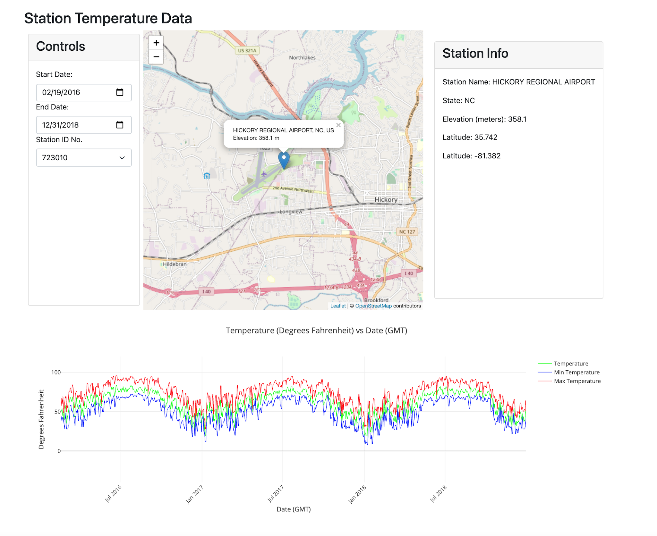
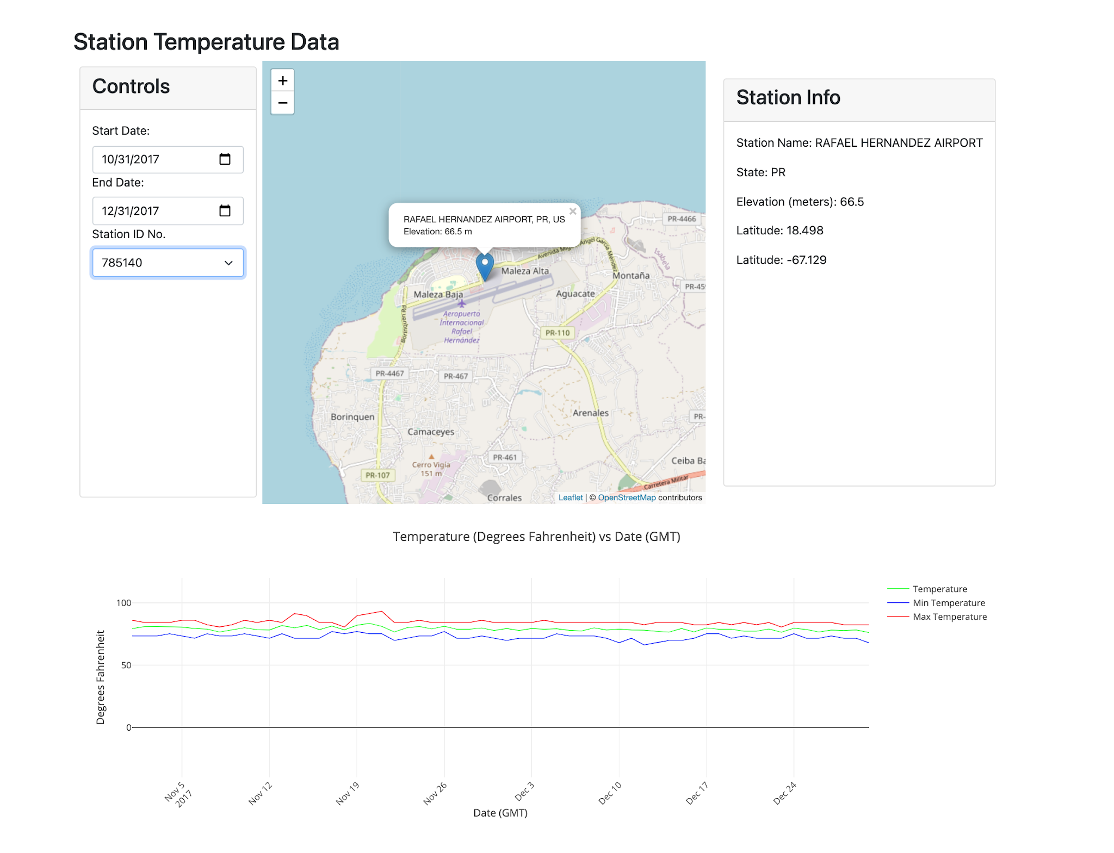
Visualizations (Charting and Mapping)
Station Selector
Notes:
Plot.Ly Charting & Leaflet Mapping with D3 as callup in our application

Slide 8
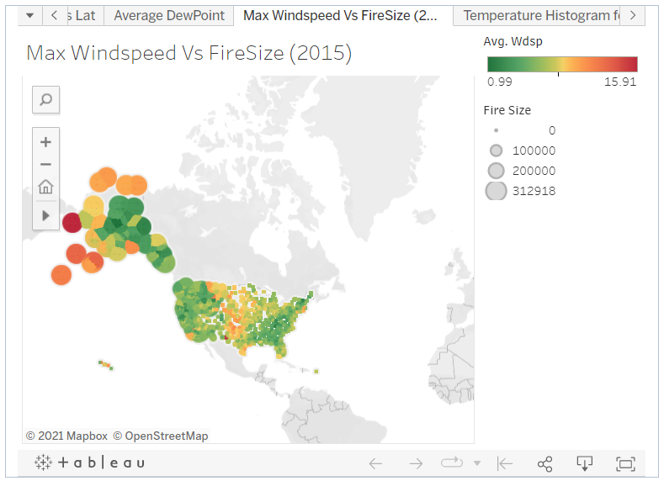
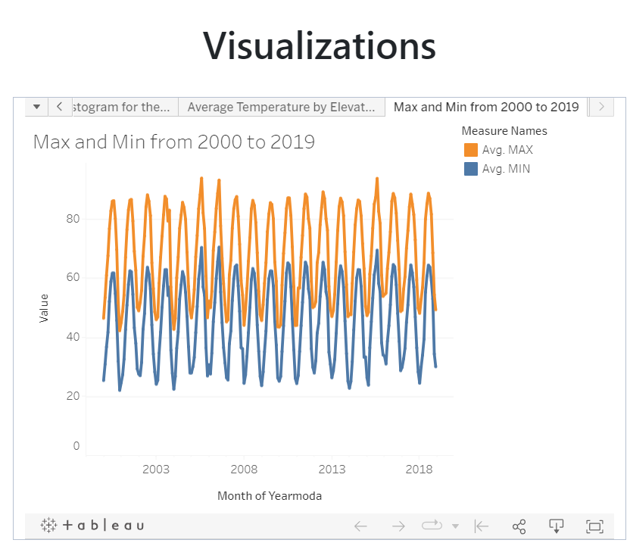
Visualizations (Charting and Mapping)

Slide 9
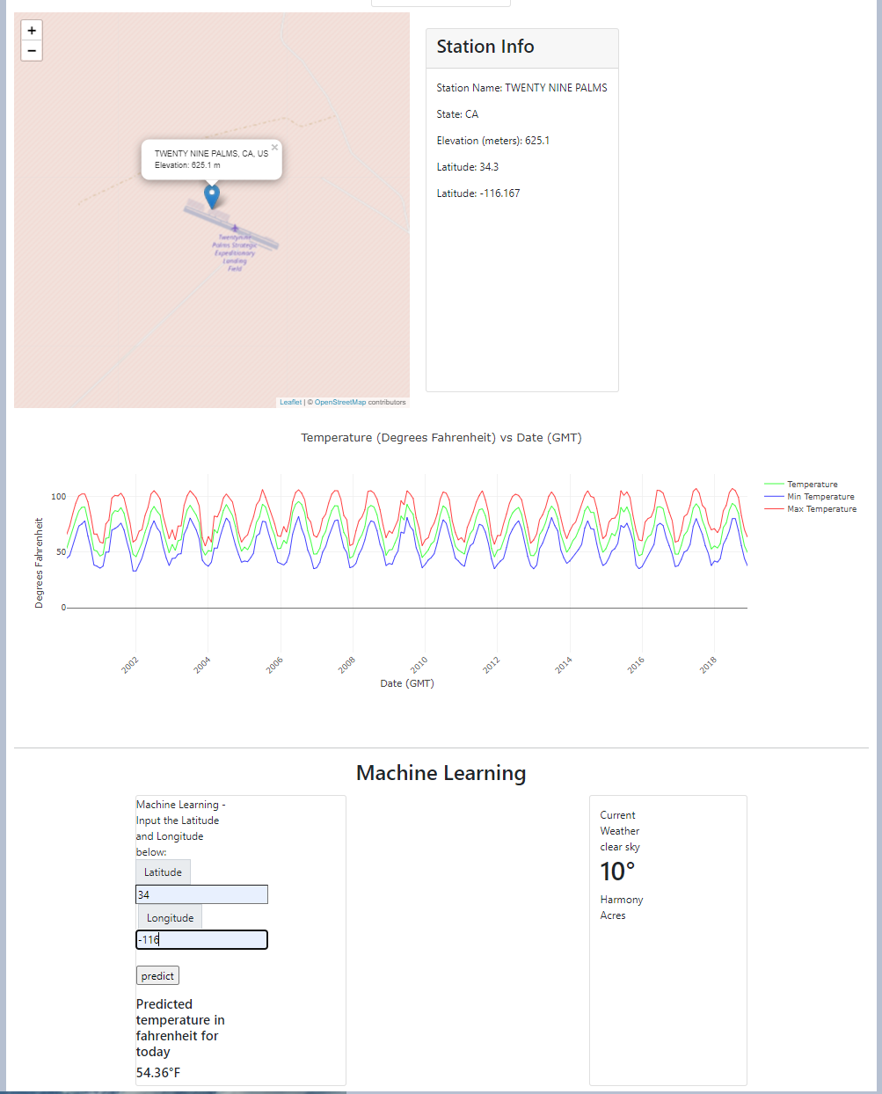
Machine Learning

Slide 10
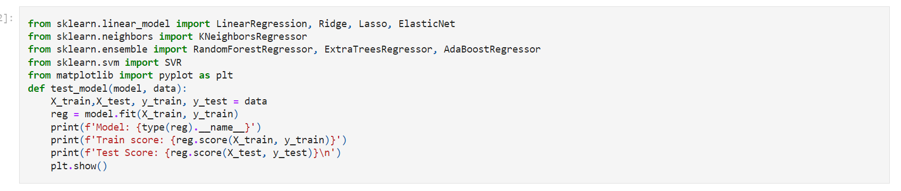
OUR PROJECT (AdaBoost)
Insert your multimedia content here

Slide 11
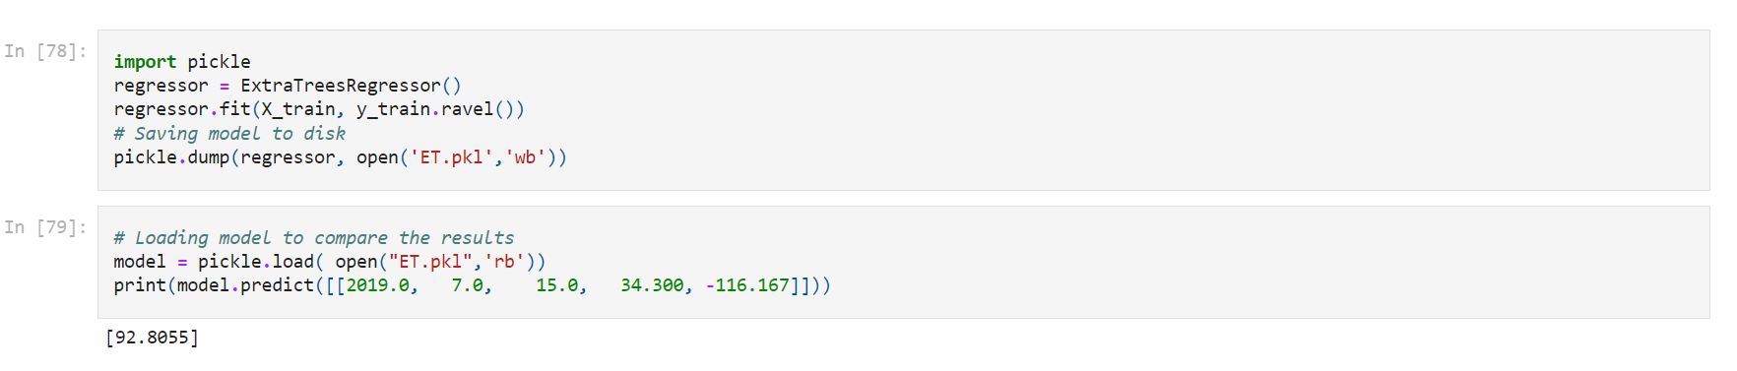
OUR PROJECT (Pickle Files)
Insert your multimedia content here

Slide 12
QUESTIONS?
Notes:
Next Steps,
Improve loading process
Switch Station ID to Station Name for Selector
Link Selector for Stations to Dinural Temp Map (much as we did for the leaflet Map and temp range chart)

Slide 13


